Slide 1

Mini Project (KCA353)
Odd Semester
Session 2024-25
AI Powered Travel Itinerary Generator
Lakshay Goel (2300290140095)
Chaitika Bhatnagar (2300290140049)
Dhruv Sharma (2300290140054)
Project Supervisor:
Mr. Prashant Agrawal
Associate Professor
2

Slide 2
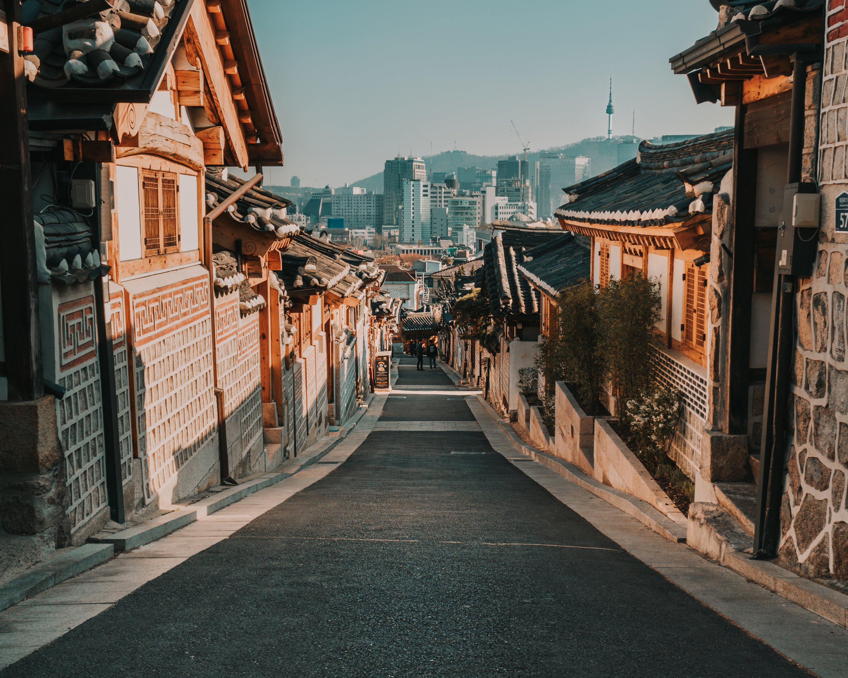
AI - Powered
Travel Itinerary generator

Slide 3

LOGO

Slide 4

Introduction:
The Al-Powered Travel Itinerary Planner is an innovative platform designed to revolutionize the way people plan their trips.
By leveraging the power of Artificial Intelligence (AI), this platform provides users with personalized travel itineraries tailored to their unique preferences, budget, and duration.
The platform's AI recommendation engine ensures that users receive the most suitable travel plans, complete with activities, accommodation options, and places to visit.
This platform aims to simplify the travel planning process, saving users time and effort while providing them with unforgettable travel experiences.

Slide 5

Literature Review
The travel industry has witnessed a significant shift towards personalized travel experiences, with travellers seeking unique and tailored itineraries. Existing travel planning platforms often rely on manual input and generic recommendations, failing to cater to individual preferences. The integration of AI technology in travel planning has been shown to improve user satisfaction and increase the efficiency of travel planning.

Slide 6
Project / Research Objective
Develop an AI-powered recommendation engine that can analyse user preferences and generate personalized travel itineraries
Design and develop a user-friendly interface that allows users to input their travel preferences and receive tailored travel plans
Integrate real-time weather updates into the platform to ensure optimal travel experiences
Develop a scalable and secure backend infrastructure to support the platform.

Slide 7
Hardware and Software Requirements
Frontend: React.js for building the user interface and user experience
Build Tool: Vite for fast and efficient build processes
Styling: Tailwind CSS for a responsive and visually appealing design
Backend: Google Firebase for scalable and secure data storage and management
AI Engine: Gemini AI for developing the AI recommendation engine.

Slide 8

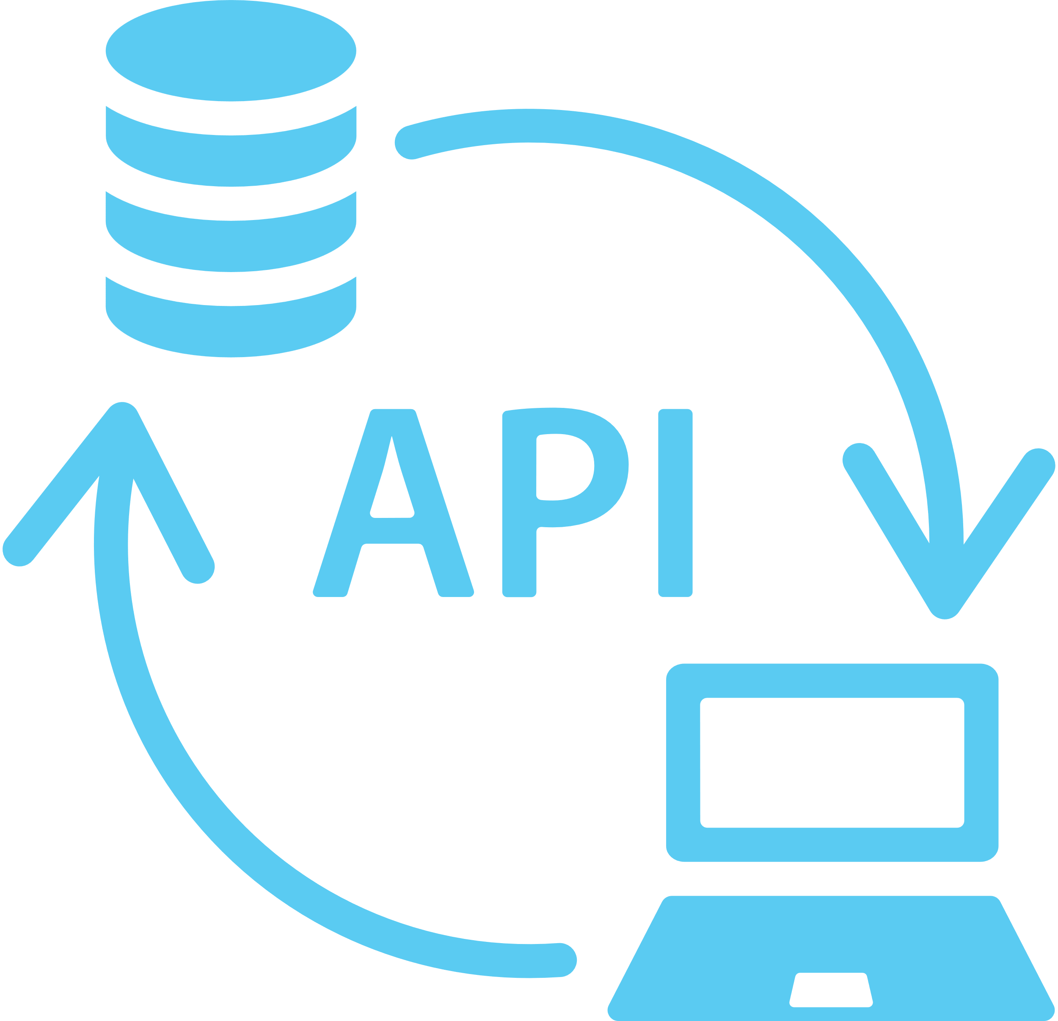
Modules
Google Firebase
Gemini

Slide 9
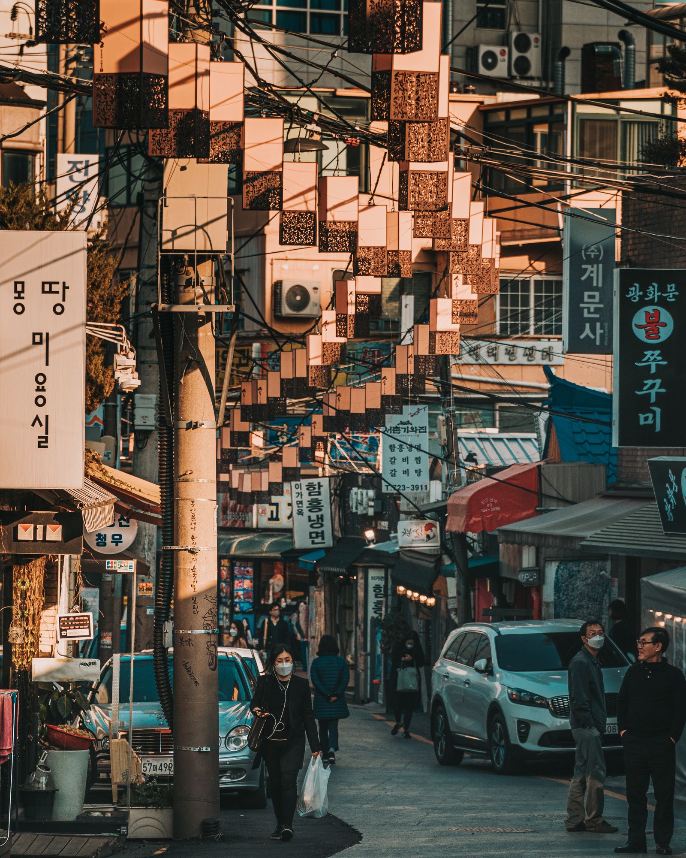
3D2N - Seoul
Flight Information
Fill in date & flight number
SIN
-
ICN
08:10
15:45
Fill in date & flight number
ICN
-
SIN
16:55
22:10
Meals
Free
Round-way price
USD 1,400/person
Luggage
30 kg/person
3

Slide 10
3D2N - Seoul
Destination
Time | Location | Description
10:00-12:00 | Gyeongbokgung Palace | Hours: 9am-5pm, closed on Tuesdays Cost: 3,000won/$2.7 Location: Sajik-ro Subway Station: Gyeongbokgung (Orange Subway Line 3)
13:30-14:30 | Bukchon Hanok Village | Hours: You can visit anytime of day but be extra respectful after dark. Cost: Free. Location: Bukchon-ro Metro stop: Gyeongbokgung or Anguk (Orange subway Line 3)
14:30-16:00 | Insadong | Here you’ll find art galleries, art stores, and plenty of adorable tea shops to stop by in. Location: Insadong-gil Metro: Anguk (Orange Line 3)
16:00-17:00 | Jogyesa Temple | Hours: 5am-9pm. Cost: Free. Location: 55 Ujeongguk-ro. Metro: Anguk (Orange Line 3) or Jonggak (Purple Line 1).
5

Slide 11
3D2N - Seoul
Cost
Term | Description | Cost
Flight ticket | Fill in the date and flight number: SIN-ICN Fill in the date and flight number: ICN-SIN Write down more description here, with max. 1 paragraph | USD1,400
Accommodation | Write down hotel's name Write down check-in and check-out date & time | USD1,400
Entrance ticket, meals, and transport | Write down more description here, with max. 1 paragraph | USD600
 | Total Cost | USD3,400
12

Slide 12
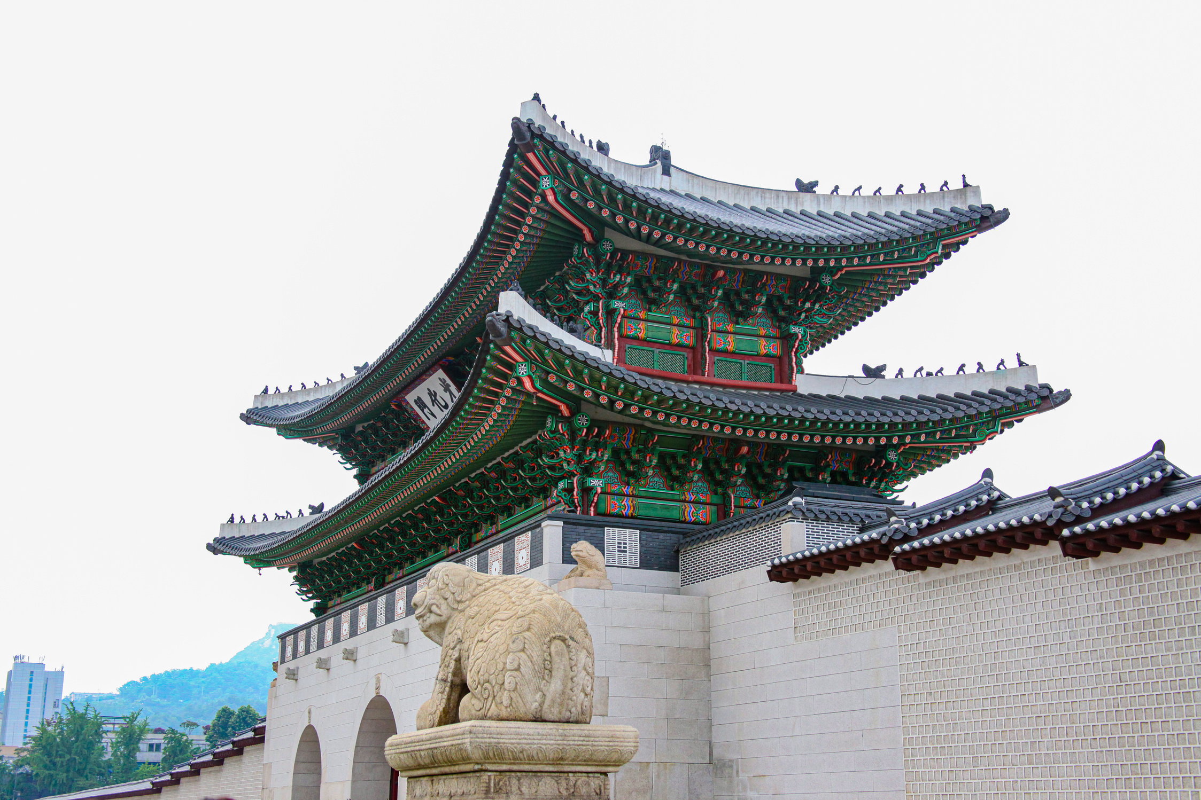
3D2N - Seoul
Day 1 - Destination
10:00-12:00
Gyeongbokgung Palace
This was the main palace for 200 years of Joseon Dynasty rule, and the current restoration is stunningly detailed.
There were once 500 buildings spread out over this large complex but not all stood the test of time. Gyeongbokgung is a vast complex and can get very busy, and recommend arriving early and staying until you get hungry.
6

Slide 13
The Enf

